Slide 1
With a R Squared value of 0.75, our multiple regressive equation has a strong <linear> fit, with Smoker, Northeast and Age having the strongest correlations, enabling us to create a forecast within a 9.89% ($-508.68) range.
This is your first Executive Summary Slide highlighting your take-away story. You’ll need to fill in the headlines with the appropriate values from your FamInsureCo Analysis.
Please include the below visuals:
Correlation Column Chart Column Chart (The chart you made in Q14 will be helpful here!)
Regression Equation Chart (The Regressive Equation Chart you’ve made in Q16 will be helpful here)
Ultimately, you want to showcase which variables are most strongly correlated to medical insurance charges and how effective your regression model is.
Note: We’ve included a sample headline for you – you can feel free to use this or modify this as you see fit

Slide 2
Analysis of medical insurance charges against BMI weight classification yields a weakly linear relationship, where costs increase as the BMI increases. However, we note there exists different pricing clusters, where high BMIs exist, but medical charges remain relatively low.
Please include the below visuals:
BMI vs Medical Insurance Charges classified by Weight Classification (i.e. Q2B)
Here we’re introducing our story where we’re showing the Executive management team a scatter plot highlighting how different weight classifications seem to result in higher medical charges.
Note: We’ve included a sample headline for you – you can feel free to use this or modify this as you see fit

Slide 3
Further segmentation of the data, indicates the presence of smoking seems to be correlated towards higher medical charges, irrespective of BMI classification.
Please include the below visuals:
BMI vs Medical Insurance Charges (Smoker = No ) (The graph you created from Q3 will be useful)
BMI vs Medical Insurance Charges (Smoker = Yes) (The graph you created from Q3 will be useful)
Here we’re reinforcing our story where we’re showcasing how the Medical Insurance Charges have much higher costs for individuals who smoke. This is reinforced by showing the Scatter Plots for No Smoking versus Smoking, and having this overlaid over each other.
Note: We’ve included a sample headline for you – you can feel free to use this or modify this as you see fit

Slide 4
Building on our smoking theme, it is clear to see that this trend is again present as we analyse medical insurance charges by geographic segmentation. In the absence of smoking, the mean insurance charge is $7500; however, with smoking, the mean charge is $30,000, 400% higher.
Please include the below visuals:
Box Plot – Medical Insurance Charges when Smoking = No
Box Plot – Medical Insurance Charges when Smoking = Yes
The graphs you created for Q9 will be helpful for this slide.
Here we’re reinforcing our story using a Box Plot. Here we’re showing how big the spread is in terms of Medical Insurance charges when contrasting those who smoke versus those who do not irrespective of geographical segmentation.
Note: We’ve included a sample headline for you – you can feel free to use this or modify this as you see fit

Slide 5
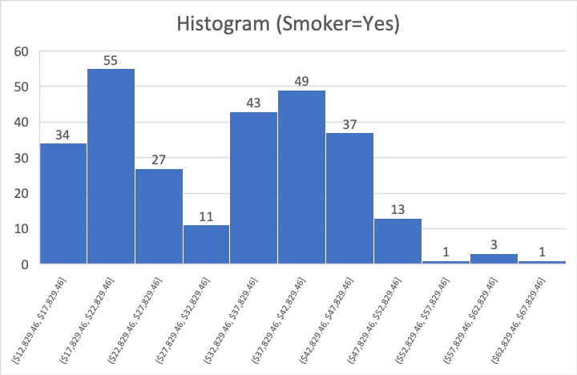
Further emphasizing the impact of smoking, the minimum medical insurance charges between those that smoke ($12.8K) and those that don’t smoke($1.1k) are as high as $11.7K (~11.4x), with the bulk of non-smokers having insurance costs less than 11K.
Please include the below visuals:
Histogram– Medical Insurance Charges when Smoking = No
Histogram– Medical Insurance Charges when Smoking = Yes
The graphs you created for Q4 will be helpful for this slide.
Here we’re reinforcing our story using a Box Plot. Here we’re showing how big the spread is in terms of Medical Insurance charges when contrasting those who smoke versus those who do not irrespective of geographical segmentation.
Note: We’ve included a sample headline for you – you can feel free to use this or modify this as you see fit

Slide 6
From an ageing lens, those who don’t smoke tend to have 2 – 3x lower costs, than those that do smoke. Specifically, the insurance charges for smokers increase by $24K (340%) and $35K (267%) for those between the Mature Age and Senior Age Groupings, respectively.
Please include the below visuals:
Stacked Column Chart (Age Profile vs Smoking Insurance Charges) (Question 5B may be helpful!)
Here we’re reinforcing our story using a combination of Stacked Column Charts and Scatter Plots. At this point we’ve clarified that Medical Insurance Charges are heavily impacted by Smoker Classification.
Note: We’ve included a sample headline for you – you can feel free to use this or modify this as you see fit

Slide 7
Lastly, segmentation of our data via gender, yields little difference, in the absence of smoking. However, in the presence of smoking, the average medical insurance charge increases by ~$25K (309%) for men versus females ($21K), a 250% increase.
Please include the below visuals:
Box Plot – Medical Insurance Charges when Smoking = No (Male vs Female)
Box Plot – Medical Insurance Charges when Smoking = Yes (Male vs Female)
The graphs you created in Q10 will be helpful!
Finally, we’re now closing out our story. We’re addressing the final concern Management has regarding Gender and the relation to Medical Insurance Costs.
Note: We’ve included a sample headline for you – you can feel free to use this or modify this as you see fit

